Slide 1

dunnhumby Hiring Challenge (React)
Participant Name: Ankit Jha

Slide 2
Brief Summary of Project:
Memes are great - they're such a fun way of describing ideas and opinions. The app works by pulling a random meme image and placing your text over the top of it to create your very own, personalized meme.

Slide 3
Technology/Tool Stack Used:
HTML
CSS
JavaScript
ReactJs
ReactStrap

Slide 4
Github URL for source code:
GithubURL: https://github.com/itsankitjha/meme-generator.git
Deploye Link: https://meme-gen25.netlify.app/

Slide 5
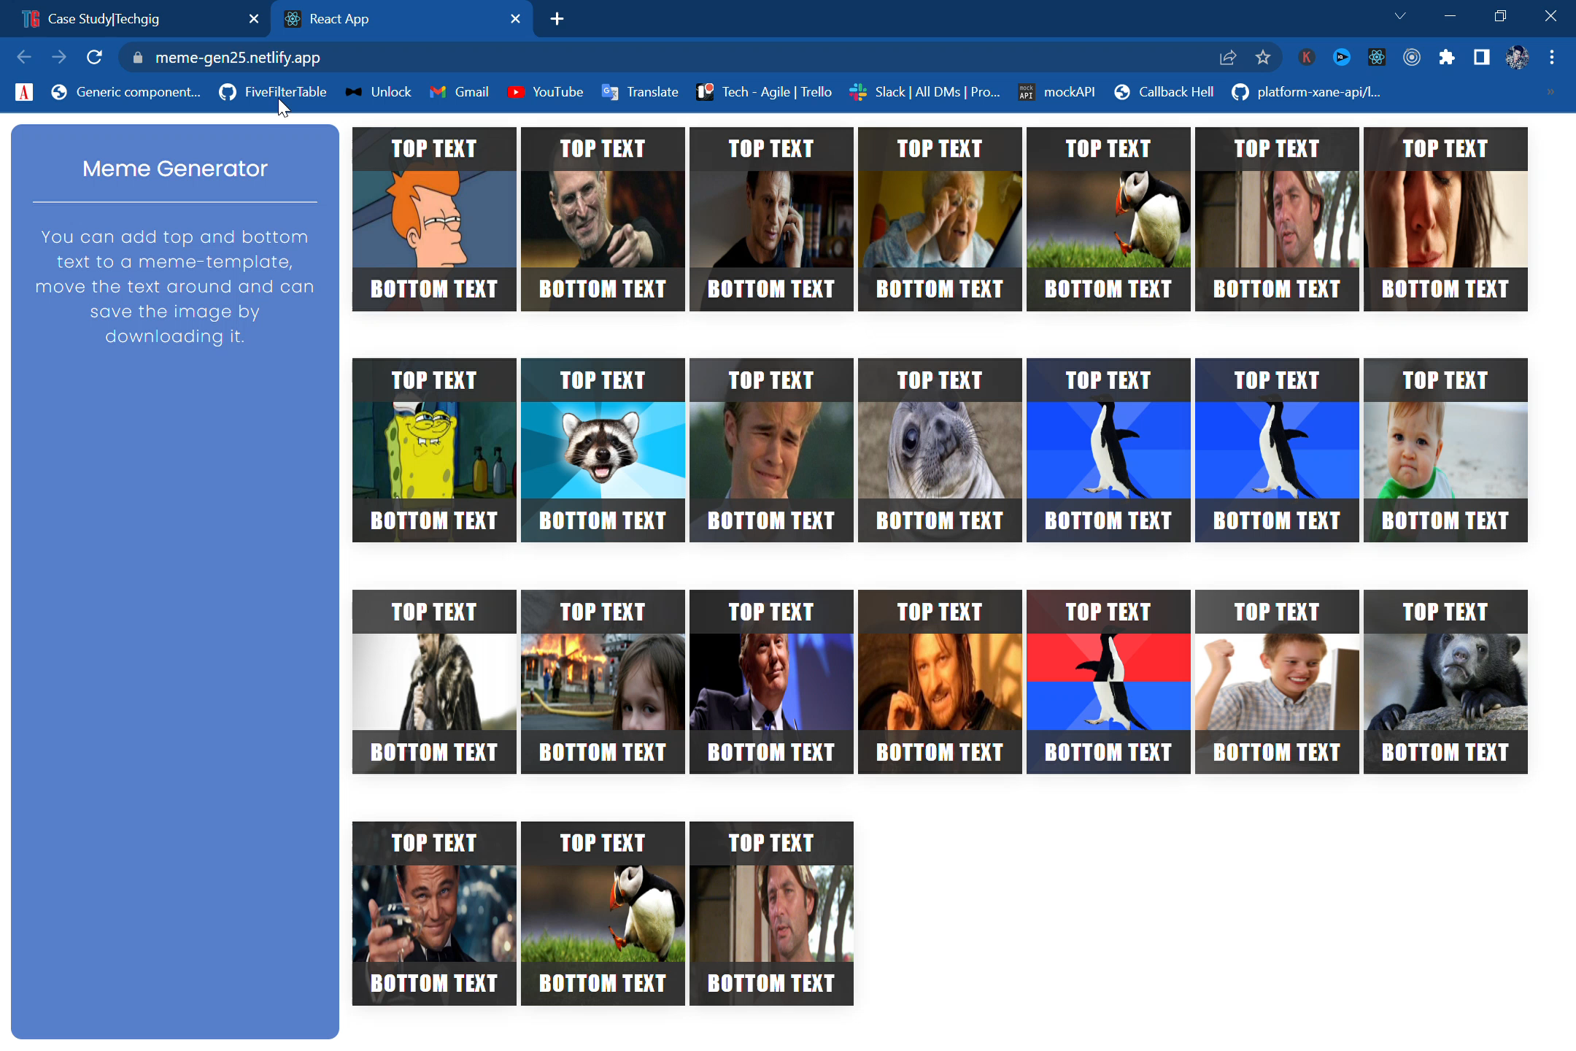
Screenshots/Video Demo of Application:
Demo Video:

Slide 6
Any Additional Information:
I could have added these features too but I didn't have much time.
we can try to fetch images from open source APIs and build a gallery.
we can try to add provisions to share them in facebook, whatsapp and twitter.
we can try to allow the user to upload their own image, scale it and create a meme.
we can try font resizing.

Slide 7
Thank You

